Slide 1


A cross platform fleet management app offering a driver behavior tracking system
Supervisor: Dr.Islam Elsharawy CO-Supervisor: Dr.momen zaher
Ahmed Diaaeldin 210137

Slide 2

Introduction 1/2
The UN goals:
Good health and Well-being
Climate action
decent work economic growth
Studies have shown that Road traffic accidents one of the biggest cause of death in many countries around the world
Driver dangerous behaviors are on of the major factors
Also, Vehicle emissions are influenced by driving style
Malekian, Reza, et al. "Design and implementation of a wireless OBD II fleet management system." IEEE Sensors Journal 17.4 (2016): 1154-1164.
L. Aarts and I. van Schagen, “Driving speed and the risk of road crashes: A review”, Accident Analysis & Prevention, vol. 38, no. 2, pp. 215-224, 2006.
World Health Organisation, Fact Sheet: “The Top Ten Causes of Death,
no.310, May 2010
Notes:
Studies have showed that Road accidents is one of the biggest causes of death in many countries
And dangerous driving behaviors are one of the main causes
And also Vehicle emissions are influenced by that

Slide 3
Introduction 2/2
Many attempts have been made to detect, predict and classify Dangerous behaviors while driving.
However, low cost solutions are still research target
Alluhaibi, Sarah Kadhim, Munaf S. Najim Al-Din, and Aiman Moyaid. "Driver behavior detection techniques: A survey." Int. J. Appl. Eng. Res 13.11 (2018): 8856-8861.
Notes:
So, the detection of driver’s dangerous behaviors have been a major study concern

Slide 4
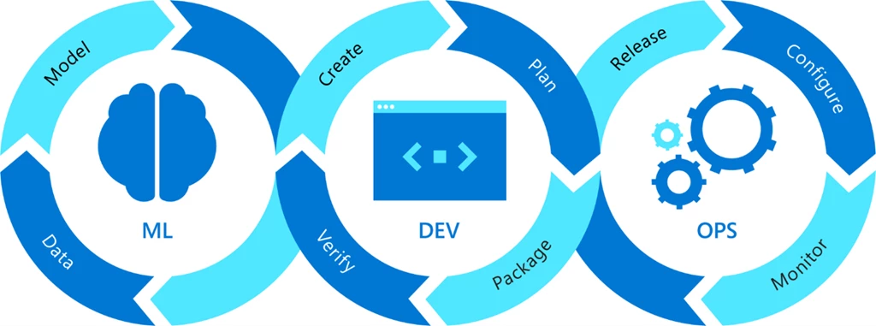
Technical Problem
A low cost solutions for dangerous behavior detection that offers high performance is still research targets
A lot of research on understanding ML algorithms, there's little on how to set them up properly
D. Kreuzberger, N. Kühl and S. Hirschl, "Machine Learning Operations (MLOps): Overview, Definition, and Architecture," in IEEE Access, vol. 11, pp. 31866-31879, 2023, doi: 10.1109/ACCESS.2023.3262138.
Alluhaibi, Sarah Kadhim, Munaf S. Najim Al-Din, and Aiman Moyaid. "Driver behavior detection techniques: A survey." Int. J. Appl. Eng. Res 13.11 (2018): 8856-8861.
https://azure.microsoft.com/en-us/blog/wp-content/uploads/2022/06/a56d354a-4d89-42dc-ada7-09097251ed4d.webp
Notes:
The technical problem is that high accuracy behavior detection with least amount of sensors is a research target,
And that rapidly bringing trained models into production is still a concern.

Slide 5
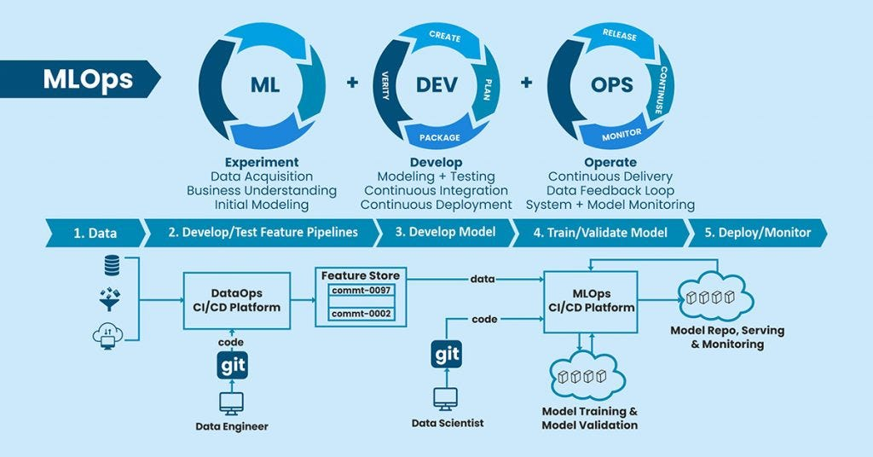
Objectives:
A Fleet management system that offers:
driver dangerous driving detection
trained models which are Rapidly in production
Continuous evaluation
Incremental training
D. Kreuzberger, N. Kühl and S. Hirschl, "Machine Learning Operations (MLOps): Overview, Definition, and Architecture," in IEEE Access, vol. 11, pp. 31866-31879, 2023, doi: 10.1109/ACCESS.2023.3262138.
https://miro.medium.com/v2/resize:fit:1024/0*MecsG1xxBo_DWtl9.jpg
Notes:
So, this project focuses on making a fleet management system that offers detecting driver Dangerous behaviors with the least amount of sensors needed as well as making sure that the models deployed in the system are always in production.

Slide 6
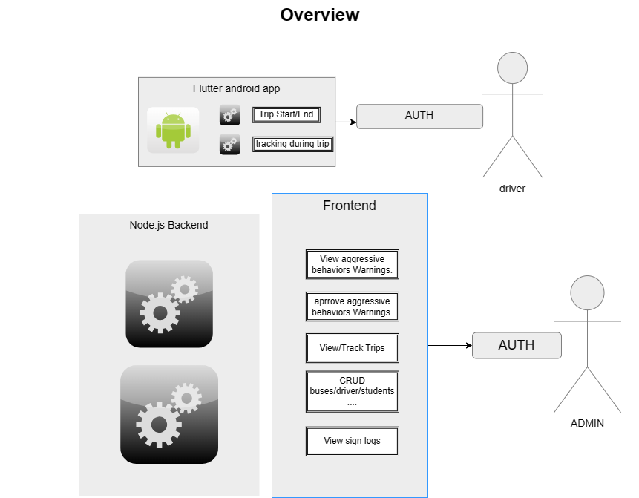










System Overview:

Slide 7
SDLC: Software Requirements
Requirements validation from fleet end-users
Following Requirements patterns where considered

Slide 8

SDLC: Software Requirements
Requirements where gathered from literature (thesis) and similar commercial systems
Systems/features | Web Driver and Vehicle management | Mobile app for Trip live monitoring and management | Vehicle conditions and maintenance | Dangerous driver behaviors detection
[1] Route-Me
[2] Web Based FMS
[3] Fleetio
Proposed System
End-user validation
[1] Wijesuriya, W. B. E. 'Route-Me'-A Mobile App and Web Based System to manage Vehicles and Drivers. Diss. 2021.
[2] Anhar, M. A. Web Based Fleet Management System for Macksons Paint Lanka (Pvt) Ltd. Diss. 2017.
[3] (Similar System) Fleetio: https://developer.fleetio.com/docs/category/guides
Notes:
We started the project with the requirements gathering, and the project was aimed for managing the fleet of the university.
So we have started gathering the main common requirements from published thesis and also from commercial apps like fleetio and until now we validatied the gathered requiements from university fleet end-users.
So in the shown table there is some of the common requirements and the machine learning part we found that it exists in systems in published papers as we will see in one of the upcoming slides.
Web Based FMS: Expenses management

Slide 9
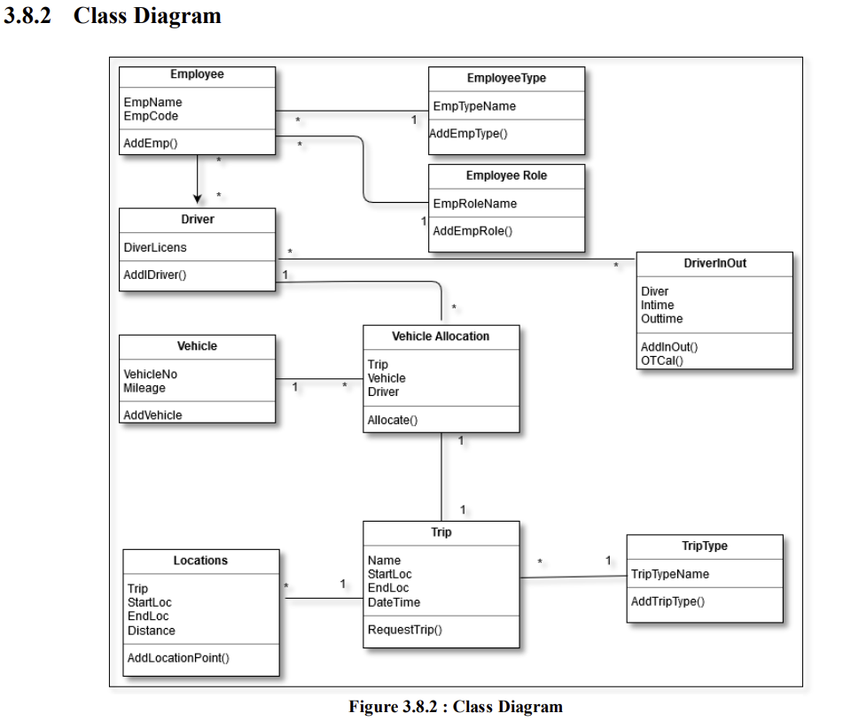
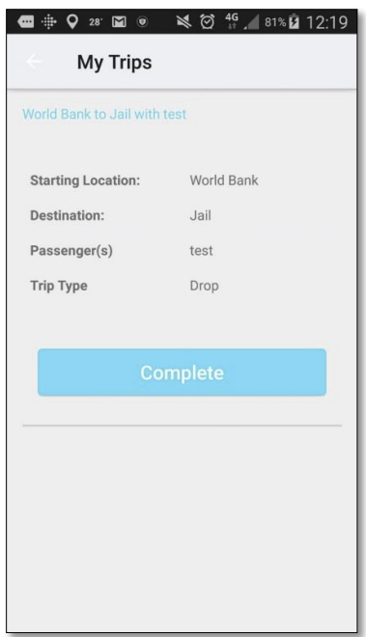
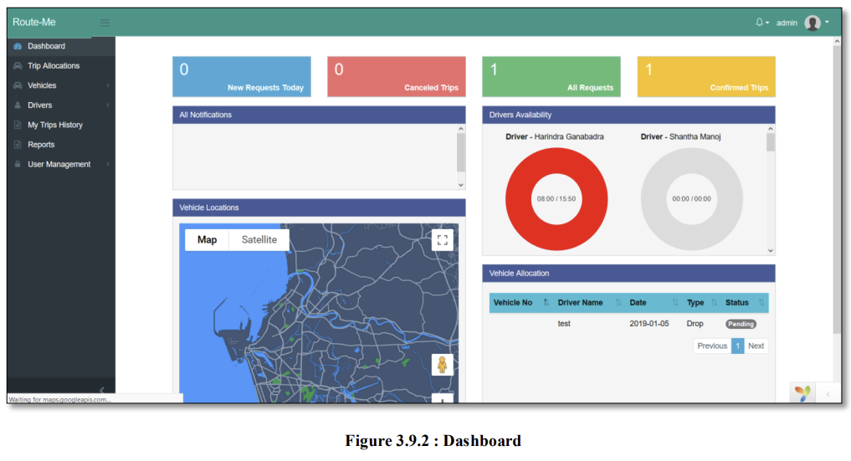
Thesis 1/2:Route me app,
A Mobile App and Web Based System to manage Vehicles and Drivers
Interviews, questionnaires, and observations
Agile Design Methodology
Wijesuriya, W. B. E. 'Route-Me'-A Mobile App and Web Based System to manage Vehicles and Drivers. Diss. 2021.
Notes:
So here is a quick overview over 2 thesis that we used as a general reference in the requiements gathering

Slide 10
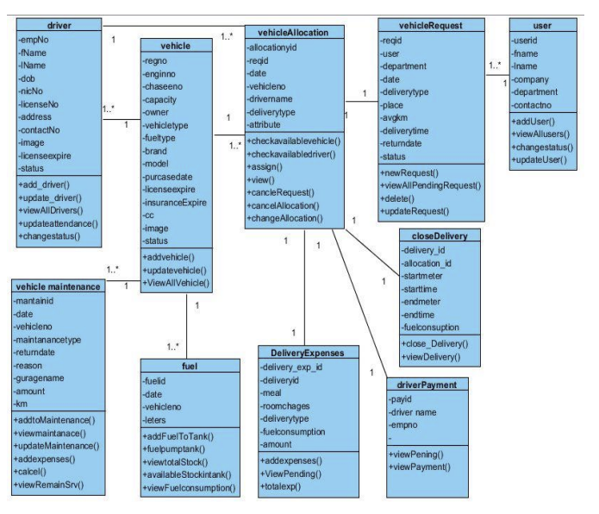
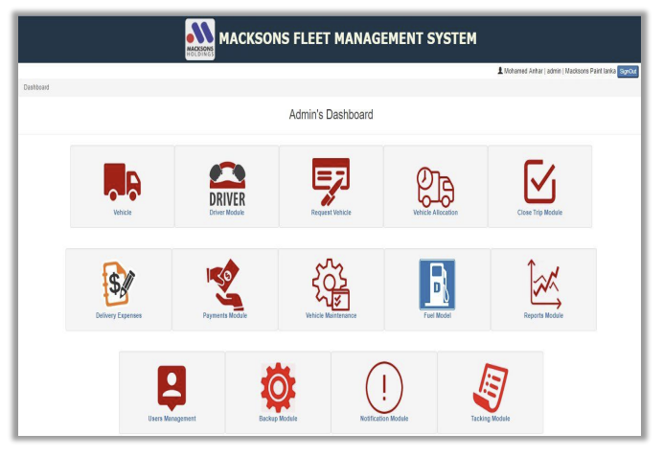
Thesis 2/2 : Web Based FMS
A Web app designed to optimize transport services
Employing interviews, observations, and document sampling to inform system requirements.
Agile Design Methodology
Anhar, M. A. Web Based Fleet Management System for Macksons Paint Lanka (Pvt) Ltd. Diss. 2017.
Notes:
Highlight the variety of techniques used to gather information, such as direct interviews with primary users like transport managers and drivers, questionnaires distributed among staff, and direct observations of the working environment.
Agile Design Methodology: Adaptive planning and early delivery for responsive and continuous system improvement.

Slide 11
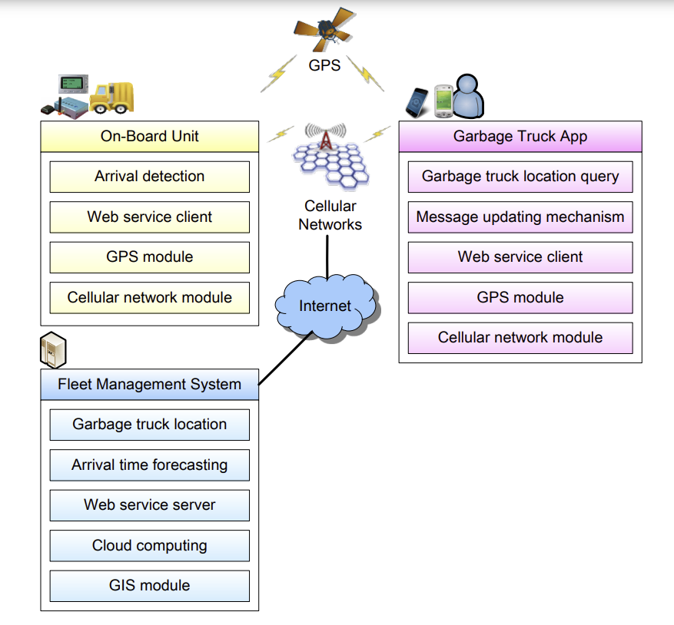
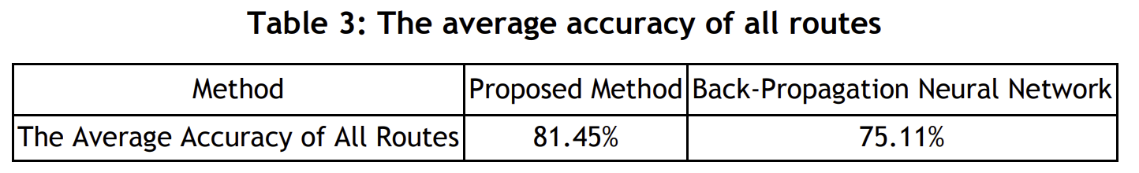
Related work 1/3: Garbage trucks FMS
Utilizes historical garbage truck trace data for arrival time forecasting
garbage truck traces in Hsinchu City from the 1st of April to the 31st of October
achieved 81.45% accuracy.
Chen, Chi-Hua, et al. "The design and implementation of a garbage truck fleet management system." South African Journal of Industrial Engineering 27.1 (2016): 32-46.
Notes:
And this project is out of our scope but it showed a hole FMS system and a utilized the algorithms to predict arrival time in a Garbage trucks management system leanier regression

Slide 12
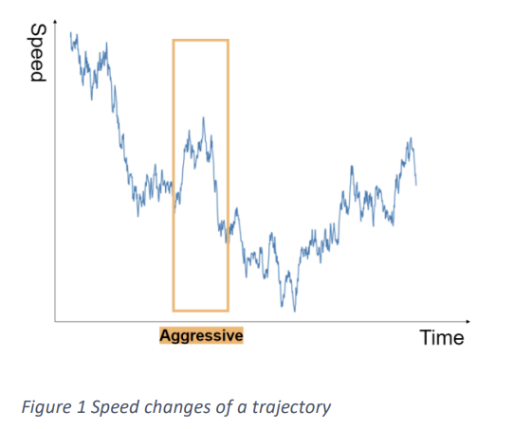
Related work 2/3 : Driving Behavior Classification Based on Oversampled Signals of Smartphone Embedded Sensors Using an Optimized Stacked-LSTM Neural Networks
This study proposes a model that can discover the aggressive driving pattern in less than 3 minutes
UAH-DriveSet, performing 3 different behaviors
99.6 percent in three minutes of driving , 93 percent accuracy in real-world testing
V. S. Padilla, A. Collaguazo, J. J. Cabrera and J. Pesantez, "M2M technology for bus fleet management. Case study: A college transportation system," 2020 IEEE Technology & Engineering Management Conference (TEMSCON), Novi, MI, USA, 2020, pp. 1-5, doi: 10.1109/TEMSCON47658.2020.9140131.
Notes:
This paper used LSTM to predect driver behavior (aggressive or normal ) PATTERN OF DRIVER SPEED BRACKING TUING classify aggressive or non-aggressive driving behaviour. GAU is just like LSTM but req. less parameters

Slide 13
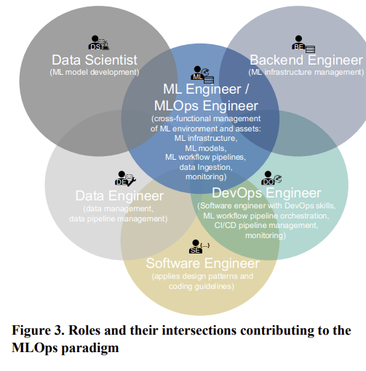
Related work 3/3 : Machine Learning Operations (MLOps): Overview, Definition, and Architecture
MLOps Definition & Architecture: The study provides a comprehensive definition of MLOps, highlighting its essential role in transitioning ML models from development to scalable, sustainable production environments.
Methodology: Utilizes a mixed-method approach to establish core principles, components, necessary roles, and workflow orchestration for effective ML operations.
D. Kreuzberger, N. Kühl and S. Hirschl, "Machine Learning Operations (MLOps): Overview, Definition, and Architecture," in IEEE Access, vol. 11, pp. 31866-31879, 2023, doi: 10.1109/ACCESS.2023.3262138.
Notes:
And this paper

Slide 14
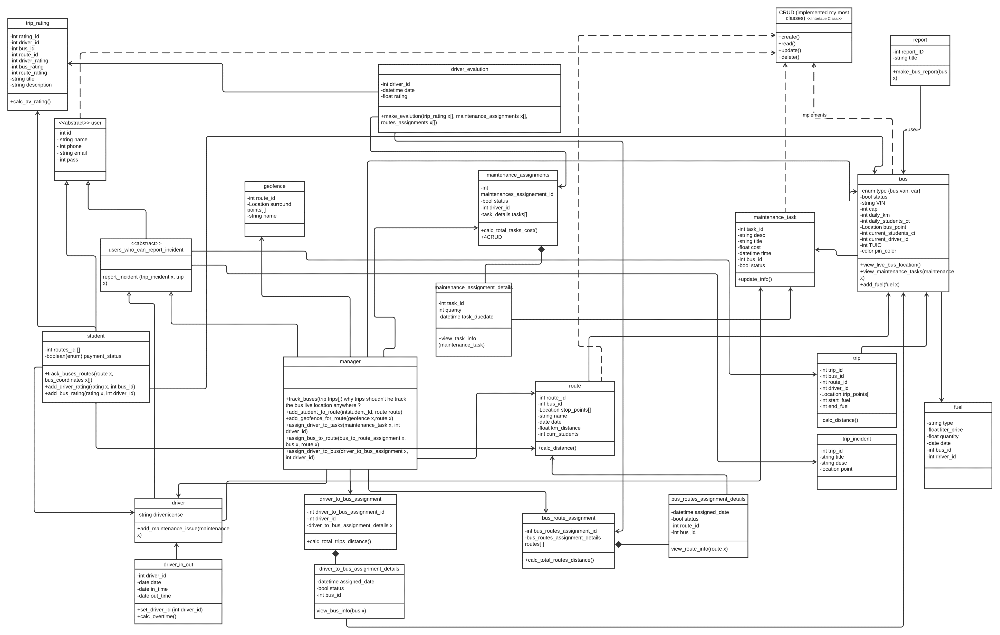

Slide 15
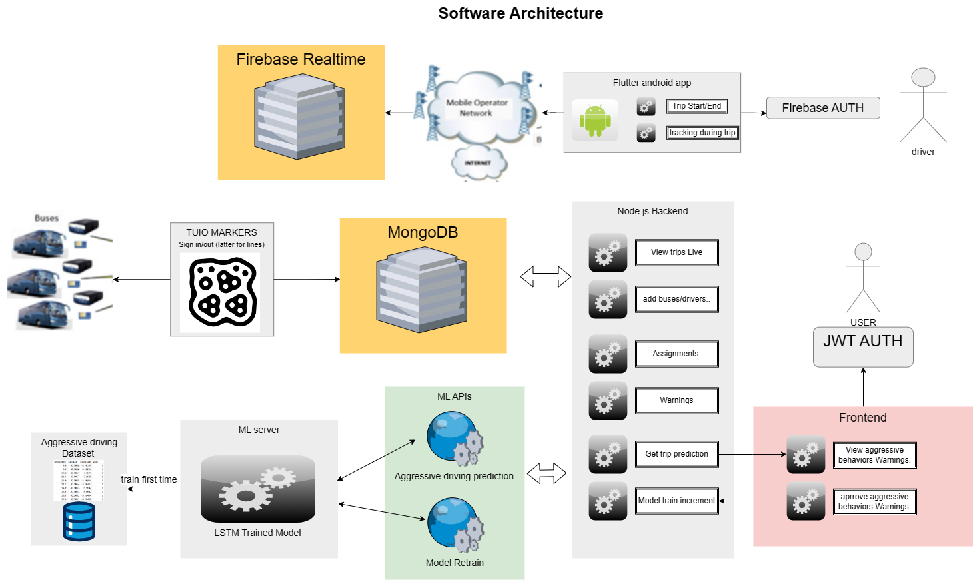
System Architecture:

Slide 16
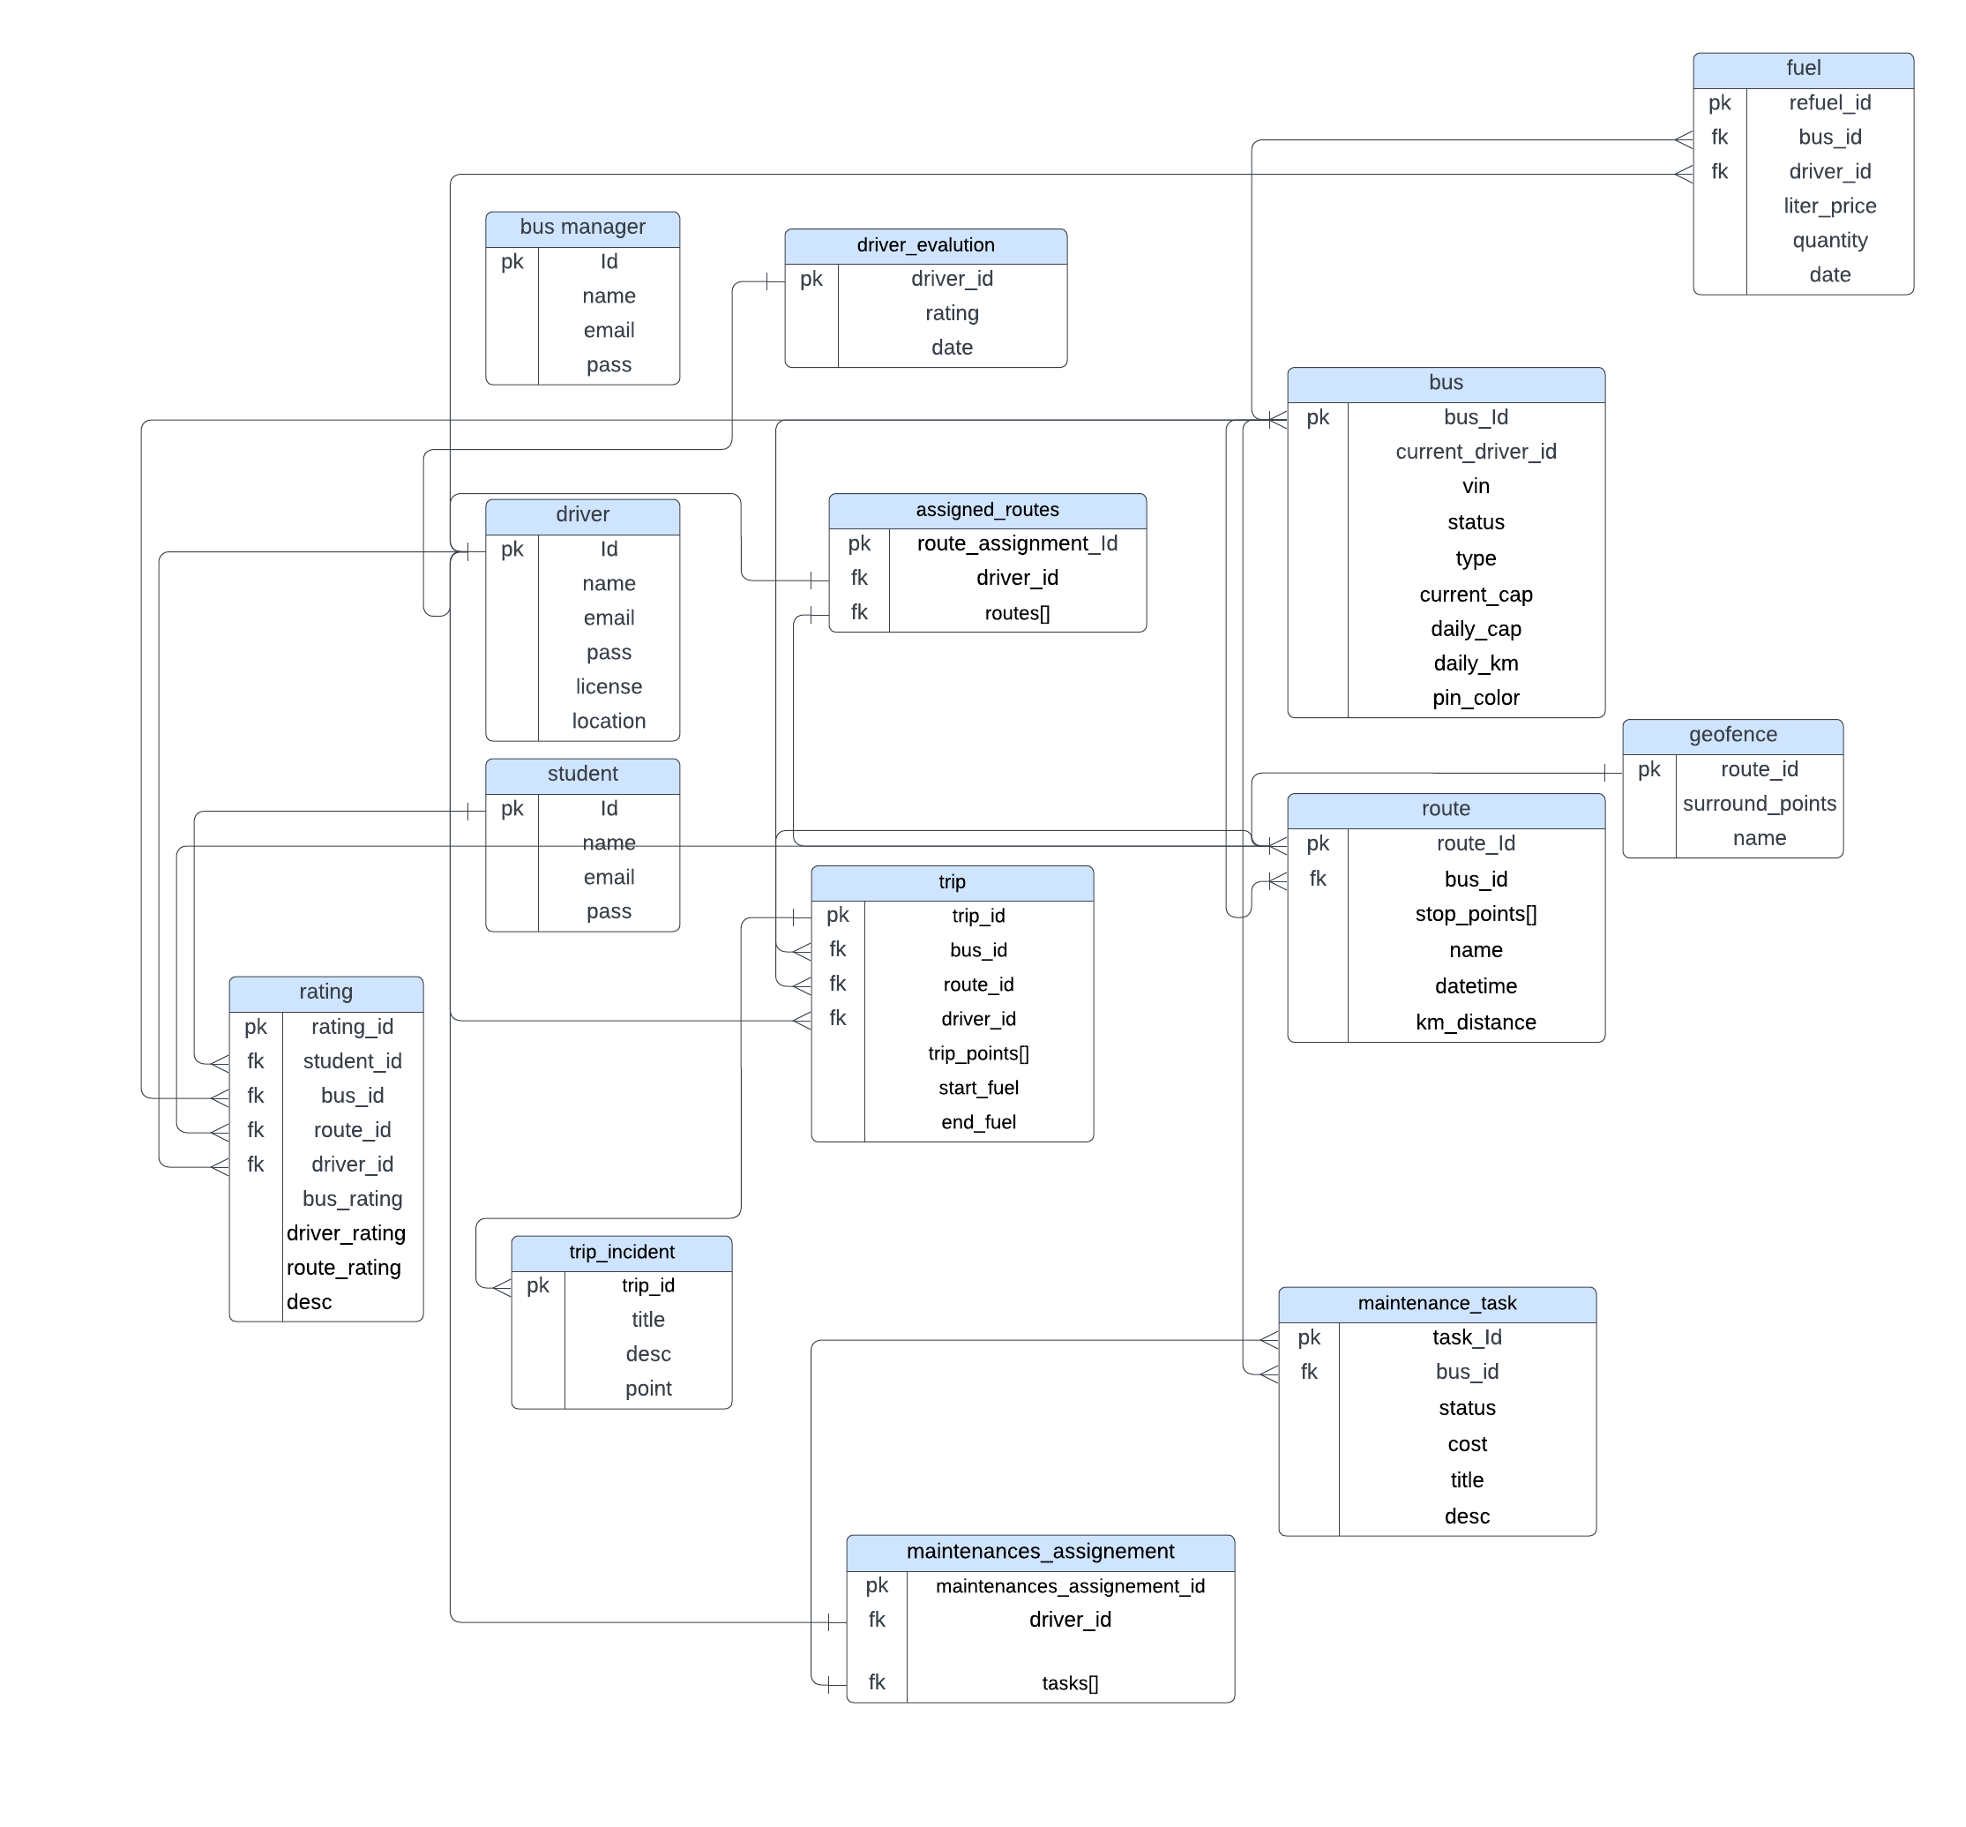

Slide 17
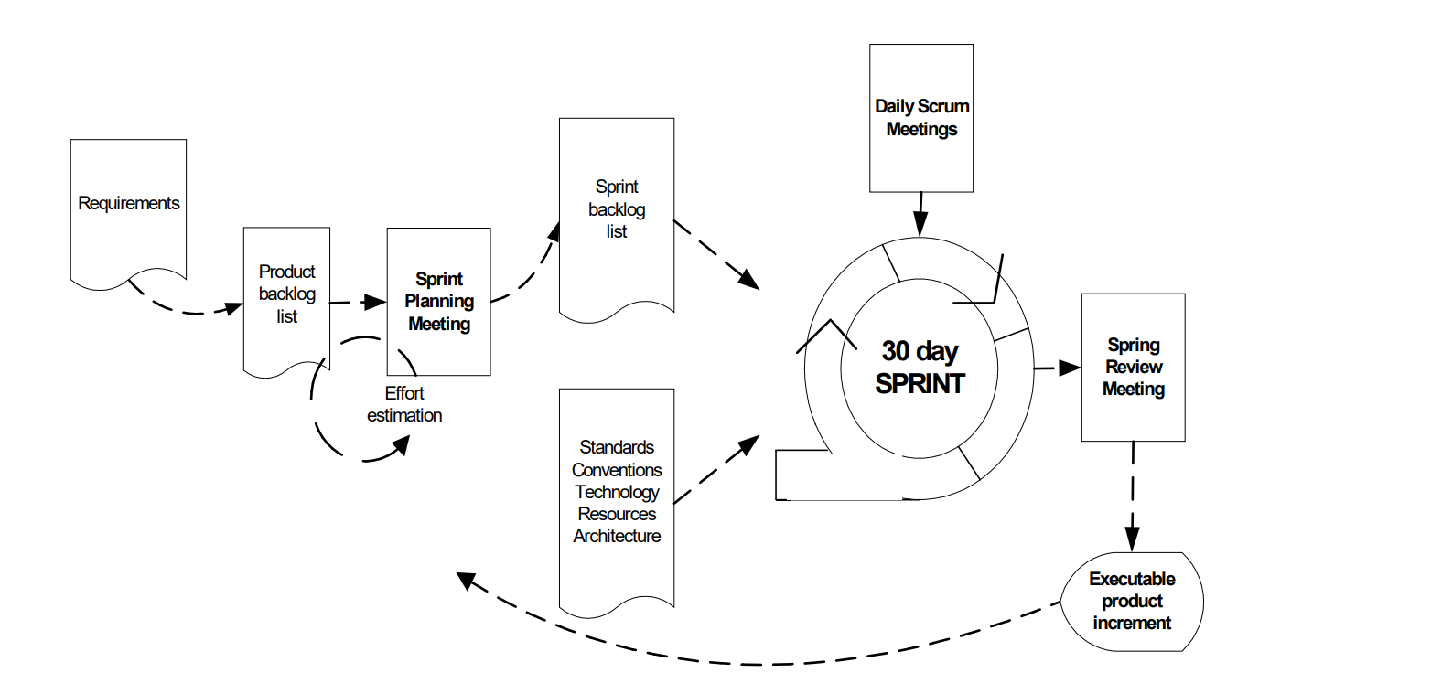


Considered Development Approach:
Abrahamsson, P., Salo, O., Ronkainen, J., & Warsta, J. (2017). Agile software development methods: Review and analysis. arXiv preprint arXiv:1709.08439.

Slide 18
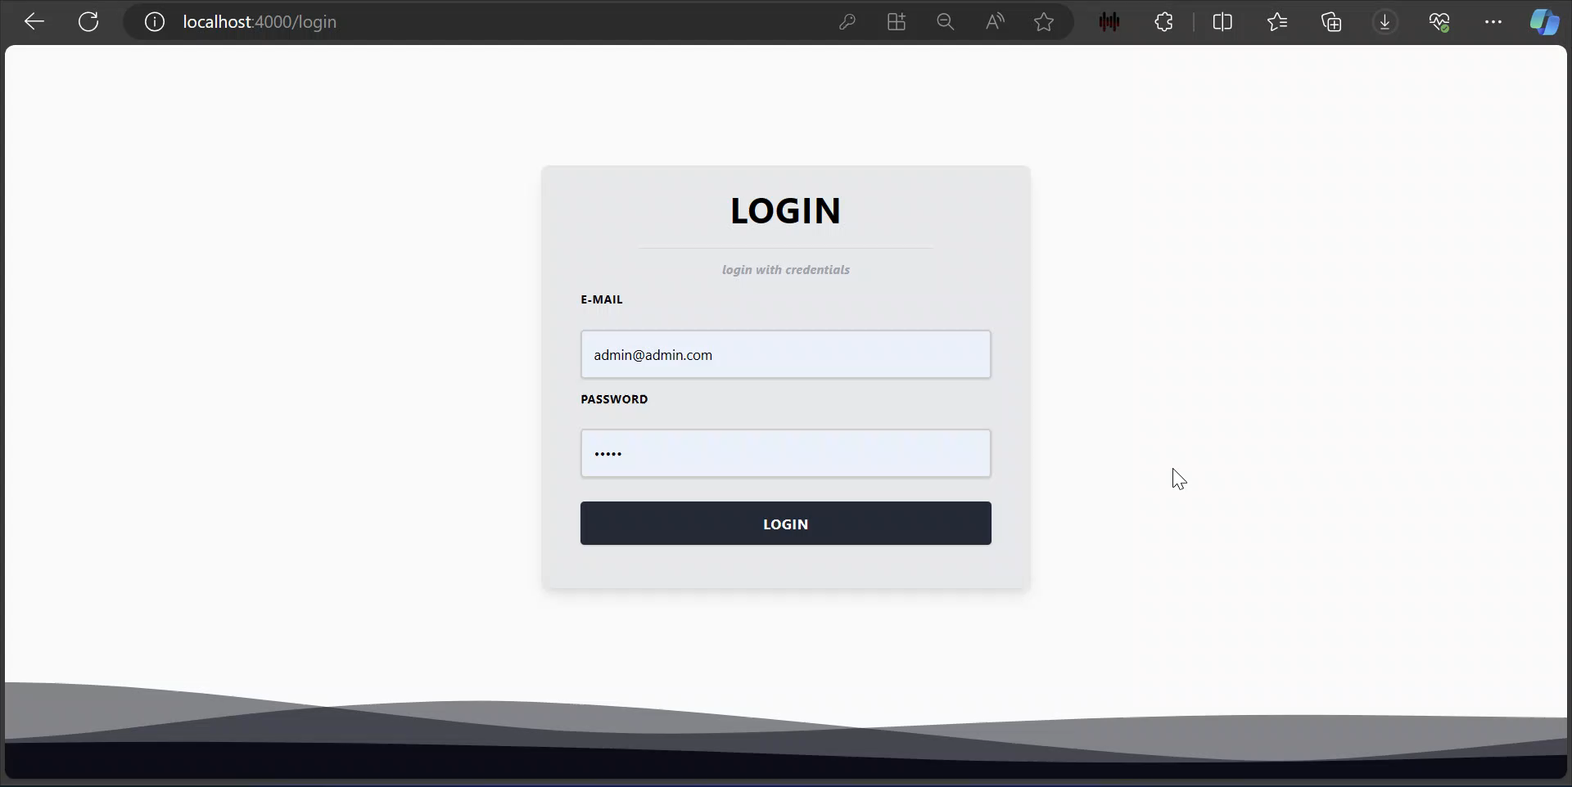
Demo web app & TUIO:

Slide 19
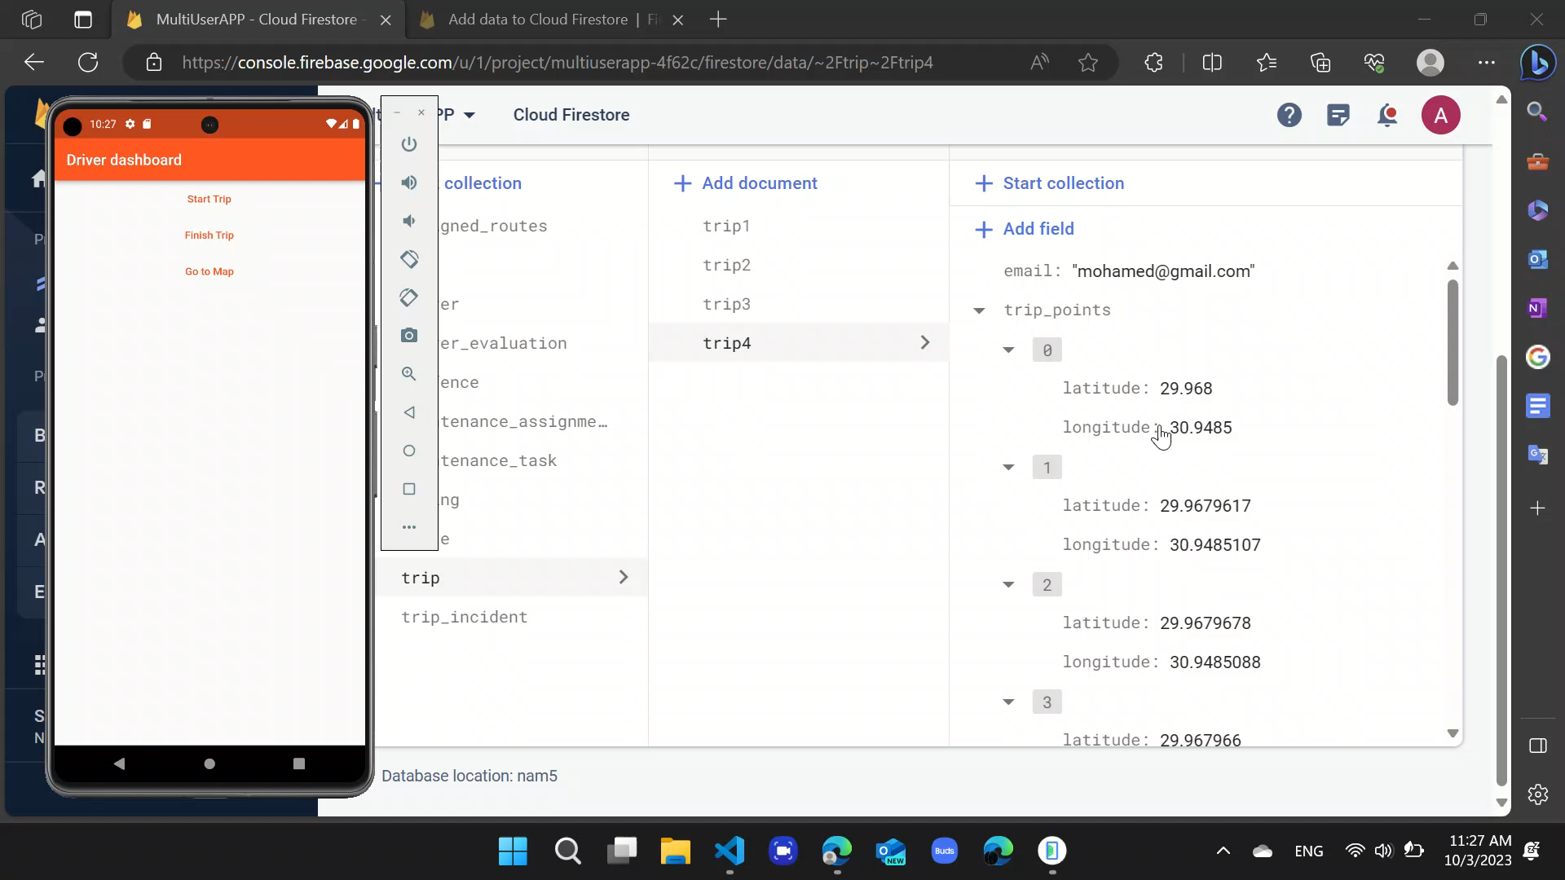

Slide 20
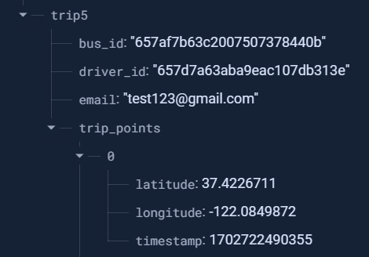

Slide 21
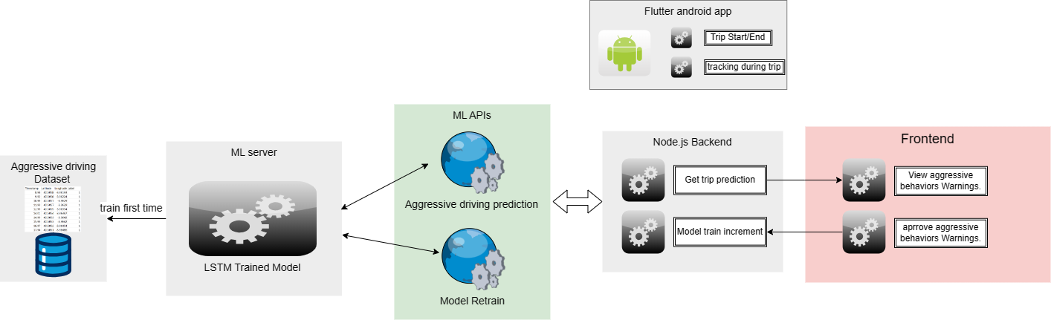
Proposed behavior detection solution:

Slide 22
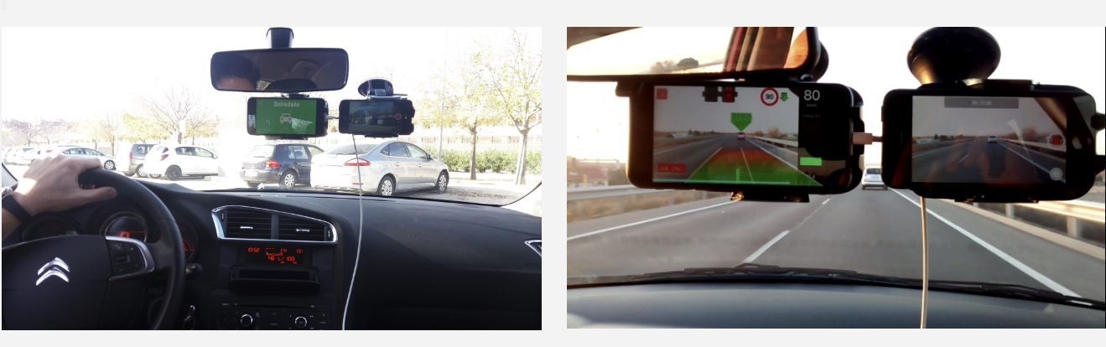
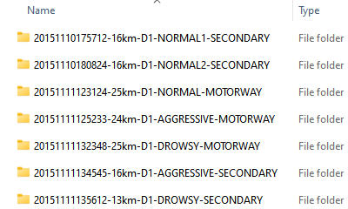
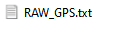
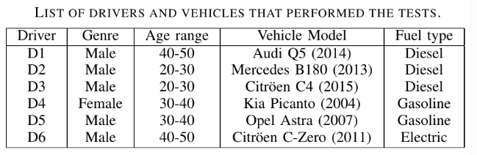
Dataset: UAH-DriveSet
captured by our driving monitoring app DriveSafe
rates each trip within 3 behavior models
( normal, drowsy (distracted) and aggressive )
E. Romera, L.M. Bergasa and R. Arroyo, "Need Data for Driving Behavior Analysis? Presenting the Public UAH-DriveSet", IEEE International Conference on Intelligent Transportation Systems (ITSC), pp. 387-392, Rio de Janeiro (Brazil), November 2016. [pdf]
Notes:
MOTORWAY UP TO 90KM

Slide 23
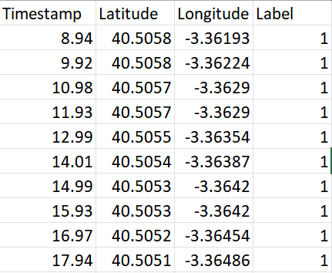
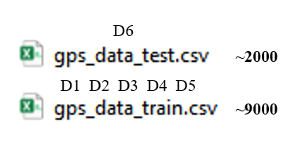

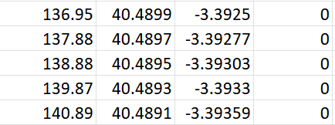
Dataset: UAH-DriveSet
We only used I training and predicted two of the labels in the dataset which are normal and aggressive
E. Romera, L.M. Bergasa and R. Arroyo, "Need Data for Driving Behavior Analysis? Presenting the Public UAH-DriveSet", IEEE International Conference on Intelligent Transportation Systems (ITSC), pp. 387-392, Rio de Janeiro (Brazil), November 2016. [pdf]
Notes:
MOTORWAY UP TO 90KM

Slide 24
LSTM Algorithm:
Before feeding to the algorithm, Data preprocessing :
Split each trip and make then independent.
The time difference rather than stamps
Long and late were normalized
Training :
Each trip was fed into the model separately.
E. Romera, L.M. Bergasa and R. Arroyo, "Need Data for Driving Behavior Analysis? Presenting the Public UAH-DriveSet", IEEE International Conference on Intelligent Transportation Systems (ITSC), pp. 387-392, Rio de Janeiro (Brazil), November 2016. [pdf]

Slide 25
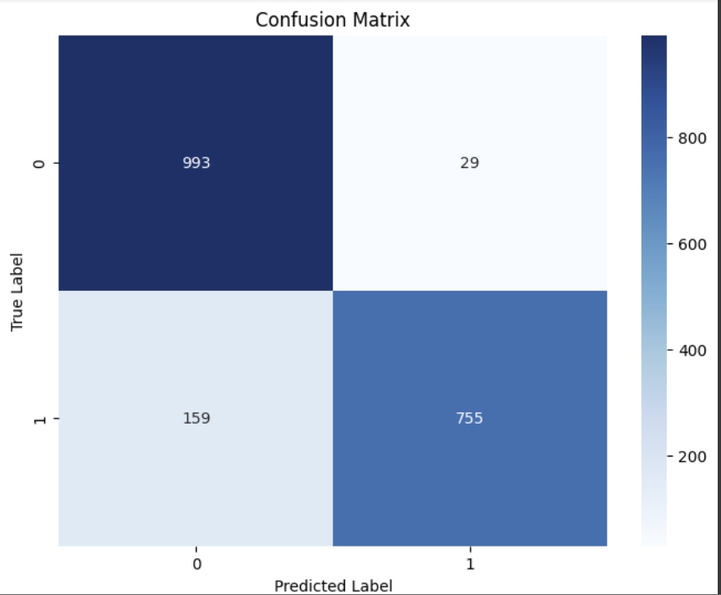
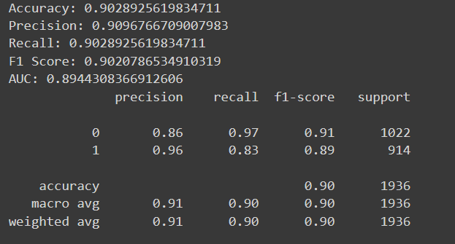
LSTM Algorithm:
Results on test data:
E. Romera, L.M. Bergasa and R. Arroyo, "Need Data for Driving Behavior Analysis? Presenting the Public UAH-DriveSet", IEEE International Conference on Intelligent Transportation Systems (ITSC), pp. 387-392, Rio de Janeiro (Brazil), November 2016. [pdf]

Slide 26
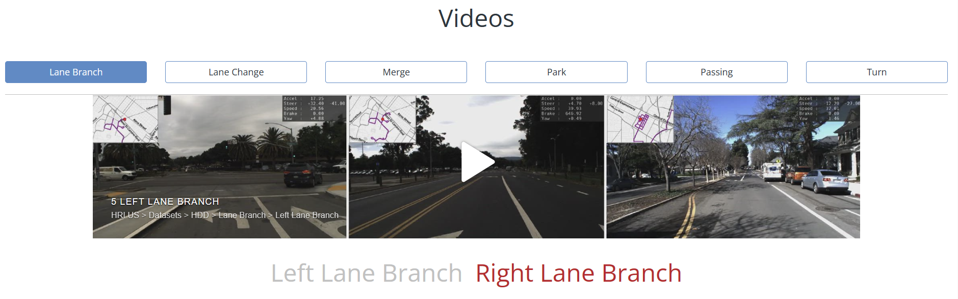
Honda Research Institution Driving Dataset (HDD):
104 hours of real human driving
Videos
Sensors.

Slide 27
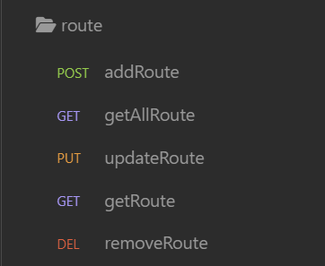
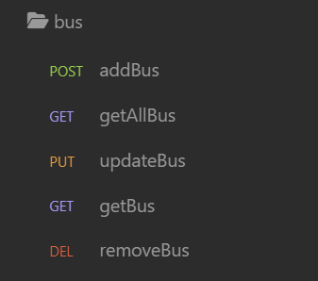
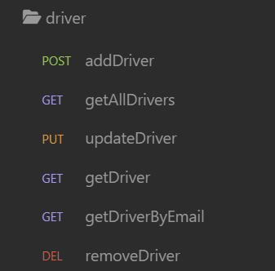
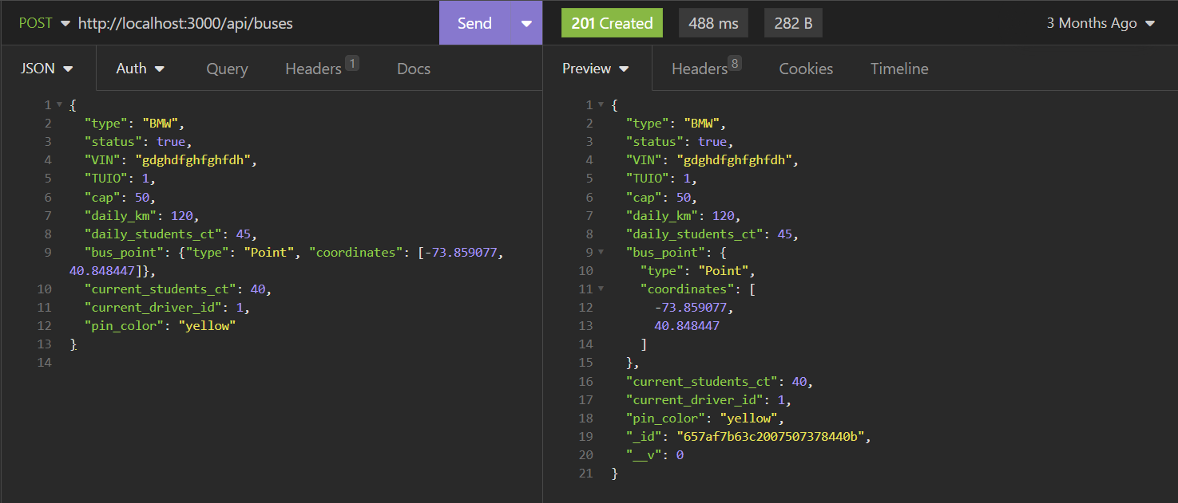
tests:

Slide 28
Integration testing:

Slide 29
Deployment: Microsoft Azure (best PAAS)
Docker => Azure Cloud

Slide 30
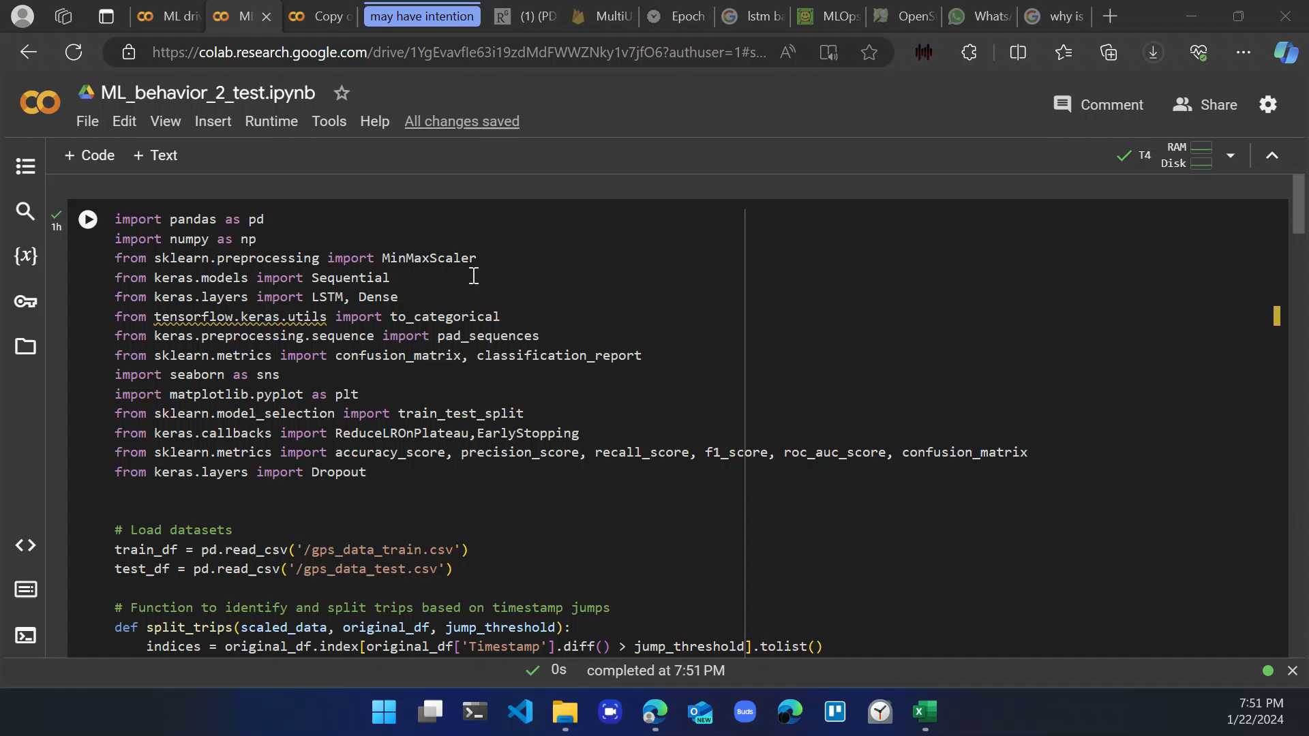

Slide 31
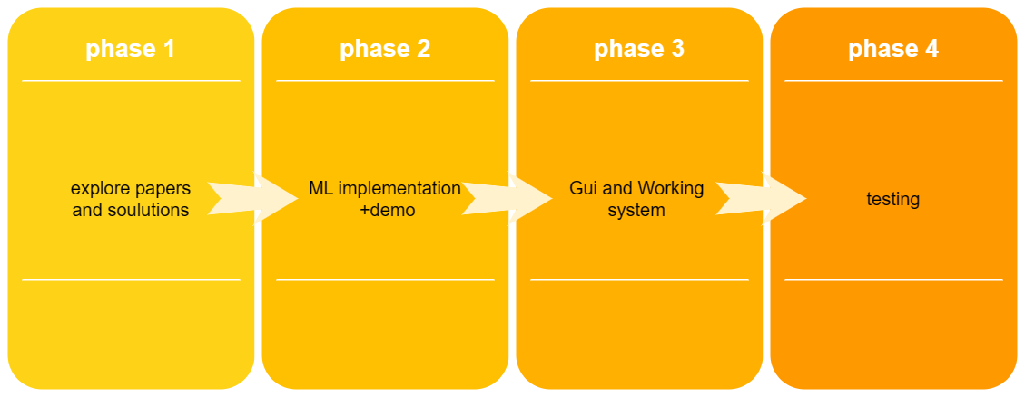

Slide 32
References
D. Kreuzberger, N. Kühl and S. Hirschl, "Machine Learning Operations (MLOps): Overview, Definition, and Architecture," in IEEE Access, vol. 11, pp. 31866-31879, 2023, doi: 10.1109/ACCESS.2023.3262138.
V. S. Padilla, A. Collaguazo, J. J. Cabrera and J. Pesantez, "M2M technology for bus fleet management. Case study: A college transportation system," 2020 IEEE Technology & Engineering Management Conference (TEMSCON), Novi, MI, USA, 2020, pp. 1-5, doi: 10.1109/TEMSCON47658.2020.9140131.
Zhao, Dengfeng, Haiyang Li, Junjian Hou, Pengliang Gong, Yudong Zhong, Wenbin He, and Zhijun Fu. 2023. "A Review of the Data-Driven Prediction Method of Vehicle Fuel Consumption" Energies 16, no. 14: 5258. https://doi.org/10.3390/en16145258
https://www.researchgate.net/publication/221720836_Road_Traffic_Injuries_and_Data_Systems_in_Egypt_Addressing_the_Challenges#:~:text=Current%20estimates%20for%20Egypt%20show,DALYs)%20lost%20in%20the%20country.
https://www.autonews.com/mobility-report-newsletter/average-time-spent-us-traffic-jams-cut-73-hours-during-pandemic-study#:~:text=Traffic%20delays%20fell%20nearly%2050,been%20wasted%20sitting%20in%20traffic.
Wanli Han, Jianyou Zhao,Driver behaviour and traffic accident involvement among professional urban bus drivers in China,Transportation Research Part F: Traffic Psychology and Behaviour,Volume 74,2020,Pages 184-197,ISSN 1369-8478,https://doi.org/10.1016/j.trf.2020.08.007.(https://www.sciencedirect.com/science/article/pii/S1369847820304897)
D. Kreuzberger, N. Kühl and S. Hirschl, "Machine Learning Operations (MLOps): Overview, Definition, and Architecture," in IEEE Access, vol. 11, pp. 31866-31879, 2023, doi: 10.1109/ACCESS.2023.3262138.

